Slide 1
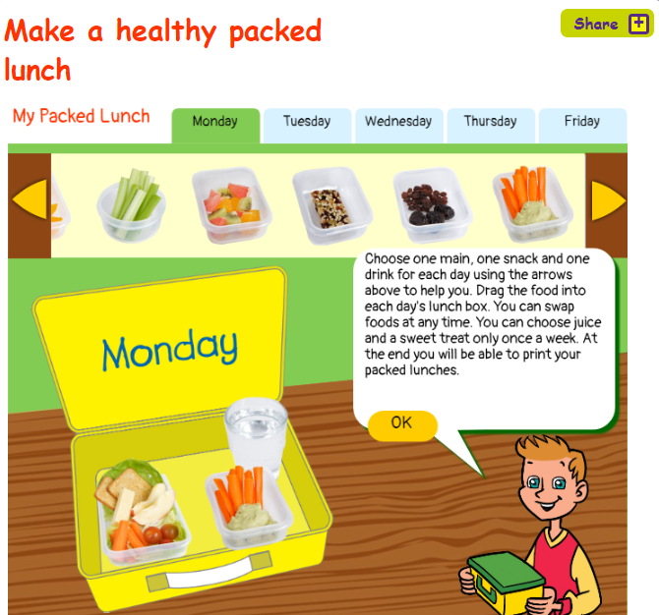
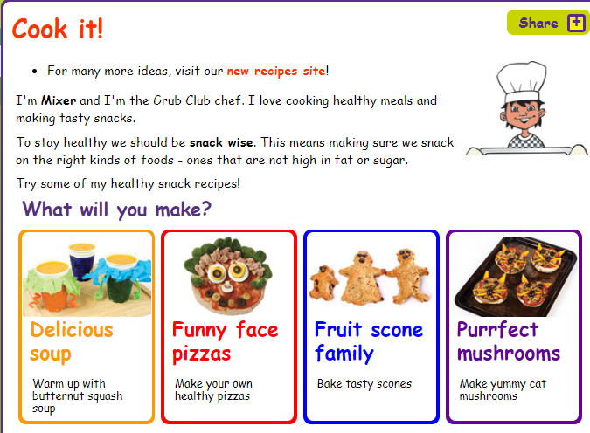
Get out and about with Packed lunches and picnics
Find lots of ideas for packed lunches on this website. Pick and plan your healthy lunches. It will make shopping for the week easier and it’s a great way to prepare for a picnic.
http://www.greatgrubclub.com/my-packed-lunch#.XPeiNRZKiws

Slide 2
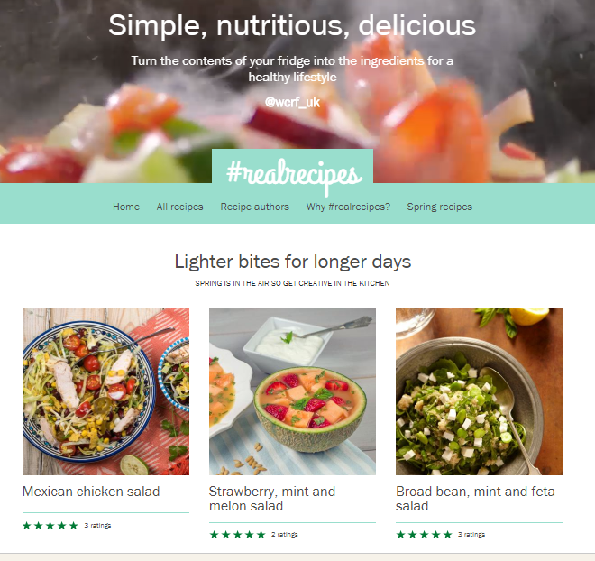
Challenge your cooking skills
If you need something more challenging why not take a look at the recipes on the World Cancer Research Fund site (WCRF)
https://www.wcrf-uk.org/uk/recipes/recipes-home
Use some of those skills you have learnt at school and apply them to an unfamiliar recipe.

